Slide 1

SEMESTER I AI6101:3 Probability Distribution
Dr. Rahul Sharma
Assistant Professor (Senior Scale)
Department of Artificial Intelligence and Machine Learning
Manipal University Jaipur
Email: sharma.rahul@jaipur.manipal.edu

Slide 2
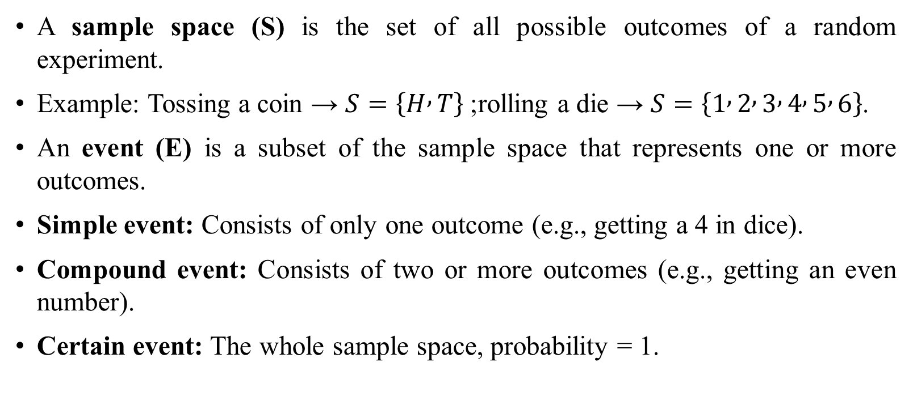
Sample Spaces and Events
A sample space (S) is the set of all possible outcomes of a random experiment.
Example: Tossing a coin → $S=\left\{H , T\right\}$; rolling a die → $S=\left\{1 , 2 , 3 , 4 , 5 , 6\right\}$.
An event (E) is a subset of the sample space that represents one or more outcomes.
Simple event: Consists of only one outcome (e.g., getting a 4 in dice).
Compound event: Consists of two or more outcomes (e.g., getting an even number).
Certain event: The whole sample space, probability = 1.

Slide 3
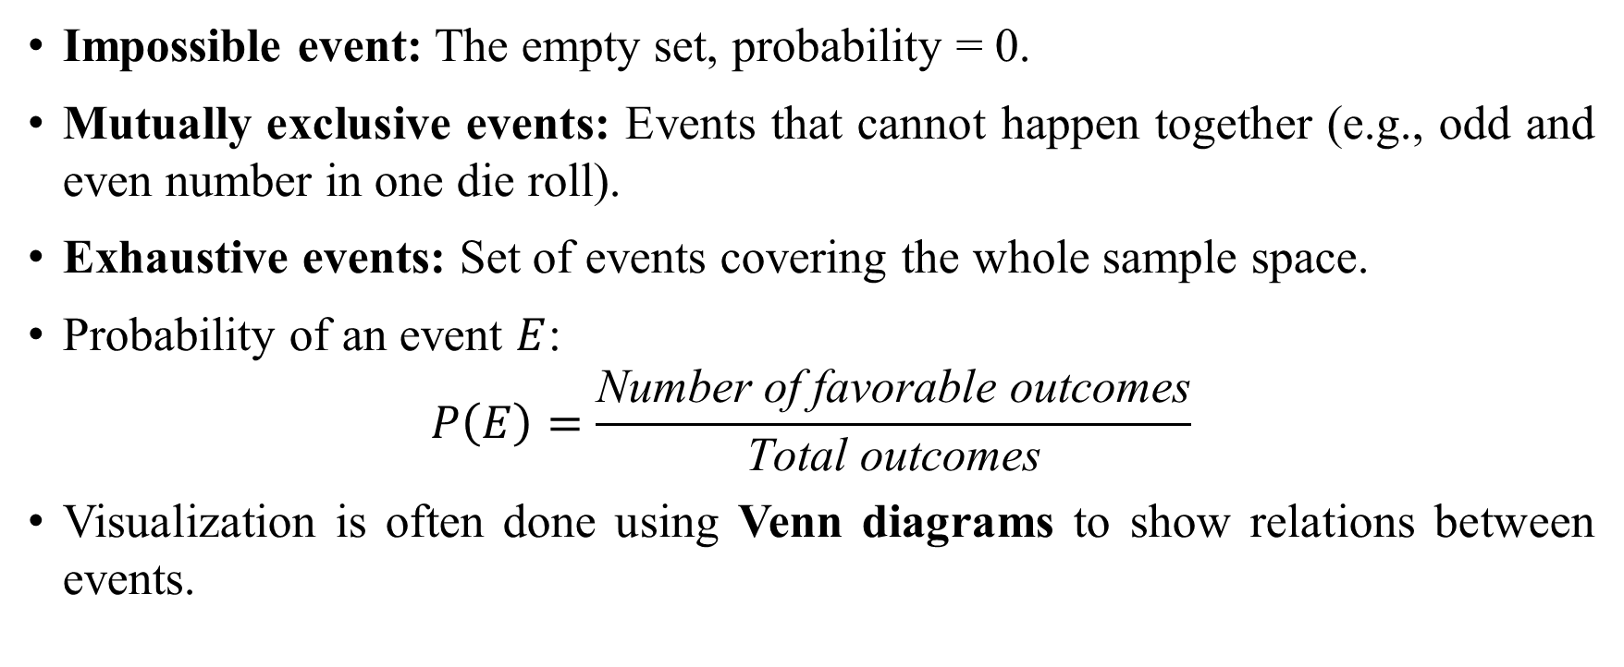
Sample Spaces and Events
Impossible event: The empty set, probability = 0.
Mutually exclusive events: Events that cannot happen together (e.g., odd and even number in one die roll).
Exhaustive events: Set of events covering the whole sample space.
Probability of an event $E$:
$$P\left(E\right)=\frac{\text{Number} \text{of} \text{favorable} \text{outcomes}}{\text{Total} \text{outcomes}}$$
Visualization is often done using Venn diagrams to show relations between events.

Slide 4
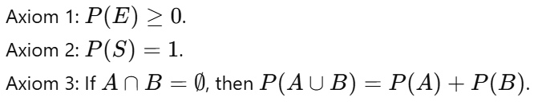
Interpretations and Axioms of Probability
Classical: Based on equally likely outcomes.
Relative frequency: Based on experiments.
Axiomatic (Kolmogorov): Modern approach.
Ensures consistency of probability.
Used in all advanced probability models.
Important in both theory & real applications.

Slide 5
Addition Rules of Probability
Used for “either-or” type problems.
For mutually exclusive events: P(A∪B)=P(A)+P(B)
For general events: P(A∪B)=P(A)+P(B)−P(A∩B).
Prevents double counting.
Venn diagrams show overlaps clearly.
Example: Drawing red card or king.
Very useful in card/dice problems.

Slide 6
Conditional Probability
Probability of A given B occurred.
Formula: P(A∣B)=P(A∩B)/P(B)
Requires P(B)>0.
Used in dependent events.
Example: Probability of red card if it’s a heart = 1.
Shown using Venn diagrams.
Also explained with probability trees.
Foundation for Bayes’ theorem.

Slide 7

Multiplication & Total Probability Rules
Multiplication rule: P(A∩B)=P(A)P(B∣A).
For independent events: P(A)P(B).
Total Probability Law:
Works with partition of sample space.
Useful for multi-step experiments.
Helps in medical/engineering problems.

Slide 8

Bayes’ Theorem
Reverses conditional probabilities.
Example: Medical testing problems.
Widely used in AI & ML.
Also applied in spam filtering.
Very useful in diagnostics.

Slide 9
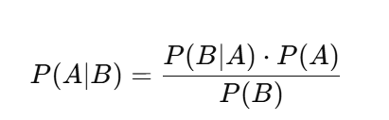
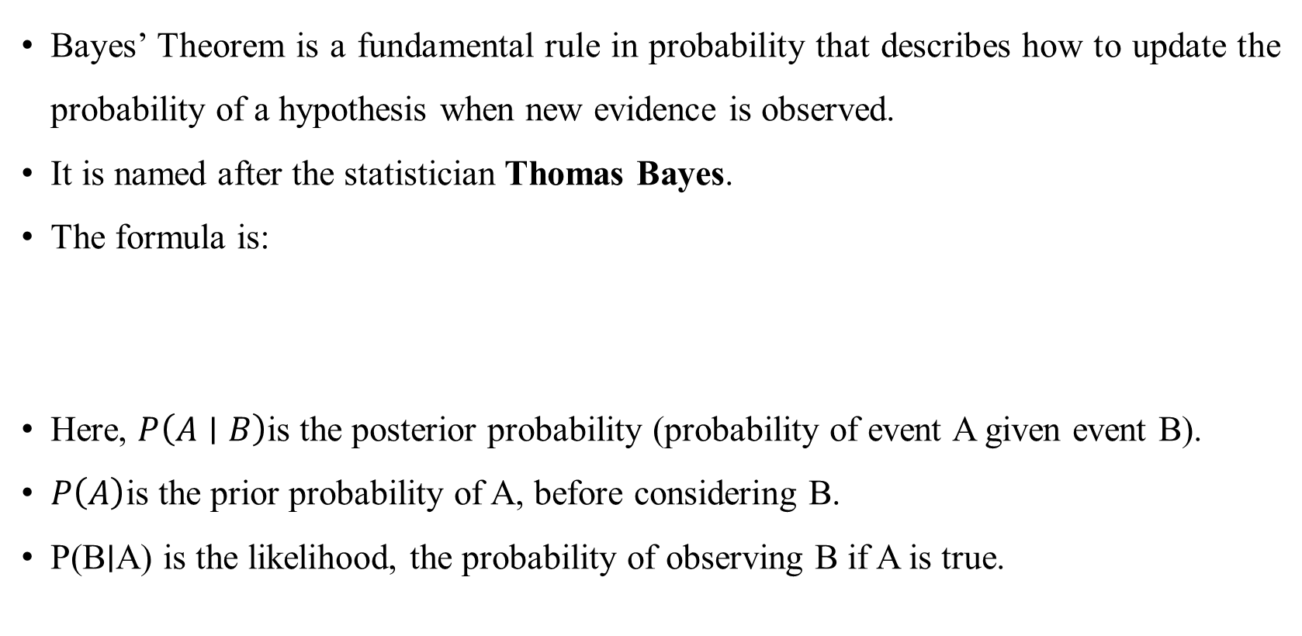
Bayes’ Theorem
Bayes’ Theorem is a fundamental rule in probability that describes how to update the probability of a hypothesis when new evidence is observed.
It is named after the statistician Thomas Bayes.
The formula is:
Here, $P\left(A∣B\right)$is the posterior probability (probability of event A given event B).
$P\left(A\right)$is the prior probability of A, before considering B.
P(B∣A) is the likelihood, the probability of observing B if A is true.

Slide 10
Bayes’ Theorem
P(B) is the marginal probability of B, acting as a normalizing factor.
It helps in revising beliefs based on new evidence.
Common applications include medical diagnosis, spam filtering, and machine learning.
For example, given a positive medical test result, Bayes’ Theorem helps estimate the probability of actually having the disease.
It bridges prior knowledge with new information for better decision-making.
Thus, it provides a powerful framework for reasoning under uncertainty.

Slide 11
Random Variables
Assigns numbers to outcomes.
Discrete: Countable values (e.g., dice).
Continuous: Uncountable (e.g., height).
Represented by probability distributions.
Link between probability & statistics.
Example: Number of heads in 3 tosses.
Basis of all probability models.

Slide 12

Bernoulli Distribution
Single trial with two outcomes.
Success (1) or failure (0).
PMF:
Mean = p.
Variance = p(1-p).
Example: Coin toss.
Foundation for Binomial distribution.

Slide 13

Binomial Distribution
Repetition of Bernoulli trials.
n independent trials, success prob = p.
PMF:
Mean = np.
Variance = np(1-p).
Example: Number of heads in 10 tosses.
Used in quality control & testing.

Slide 14

Poisson Distribution
Models rare events.
Used when n large, p small.
PMF:
Mean = λ.
Variance = λ.
Example: Calls per hour at call centre.
Used in traffic, queues, accidents.
Approximation of Binomial.

Slide 15

Normal Distribution
Continuous, bell-shaped curve.
Formula:
Mean = Median = Mode.
Symmetrical about mean.
68-95-99.7% rule applies.
Example: Heights, IQ scores.
Most used in statistics.
Basis of hypothesis testing.

